Slide 1
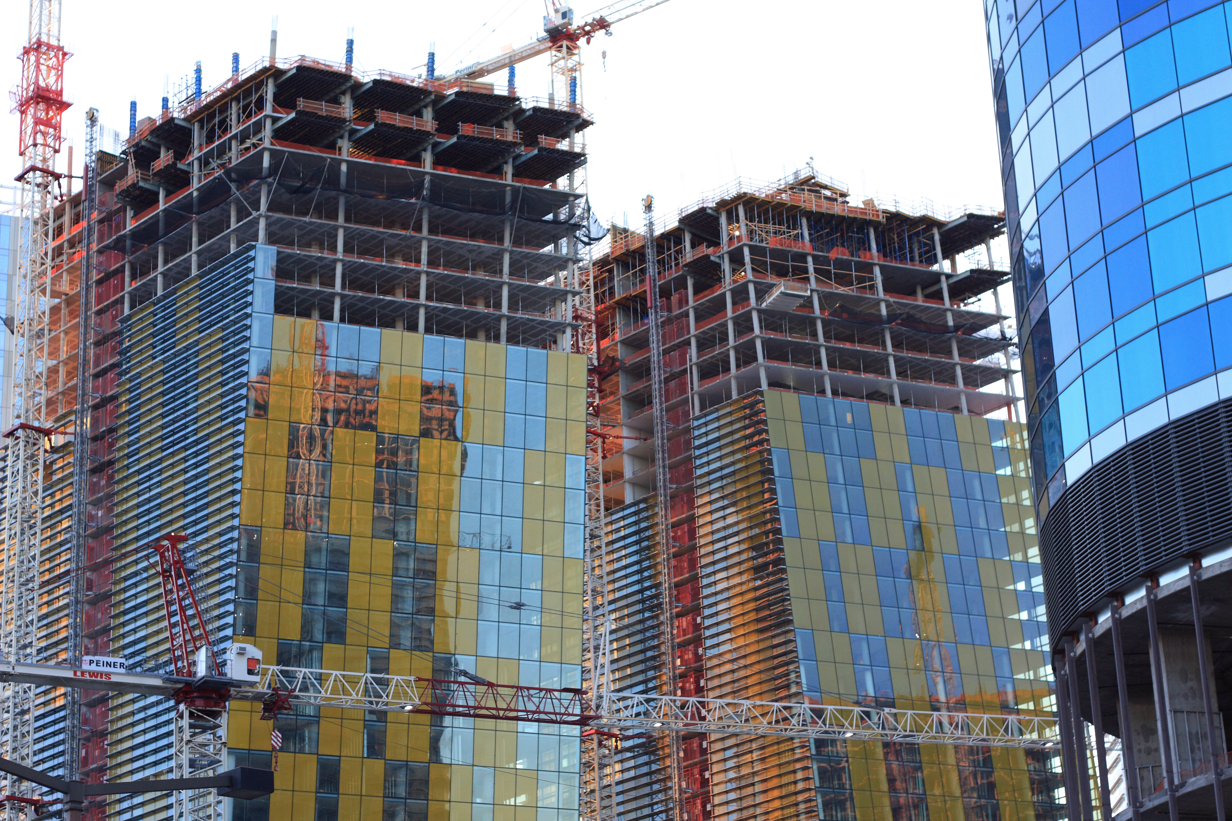
Class 3:
Elliptic Curve Cryptography
y² = x³ + 7
Cryptocurrency Café
cs4501 Spring 2015
David Evans
University of Virginia

Slide 2
Plan for Today
Bitcoin Wallets and Passwords
Asymmetric Cryptography Recap:
Transferring a Coin
Crash Course in Number Theory
Elliptic Curve Cryptography

Slide 3
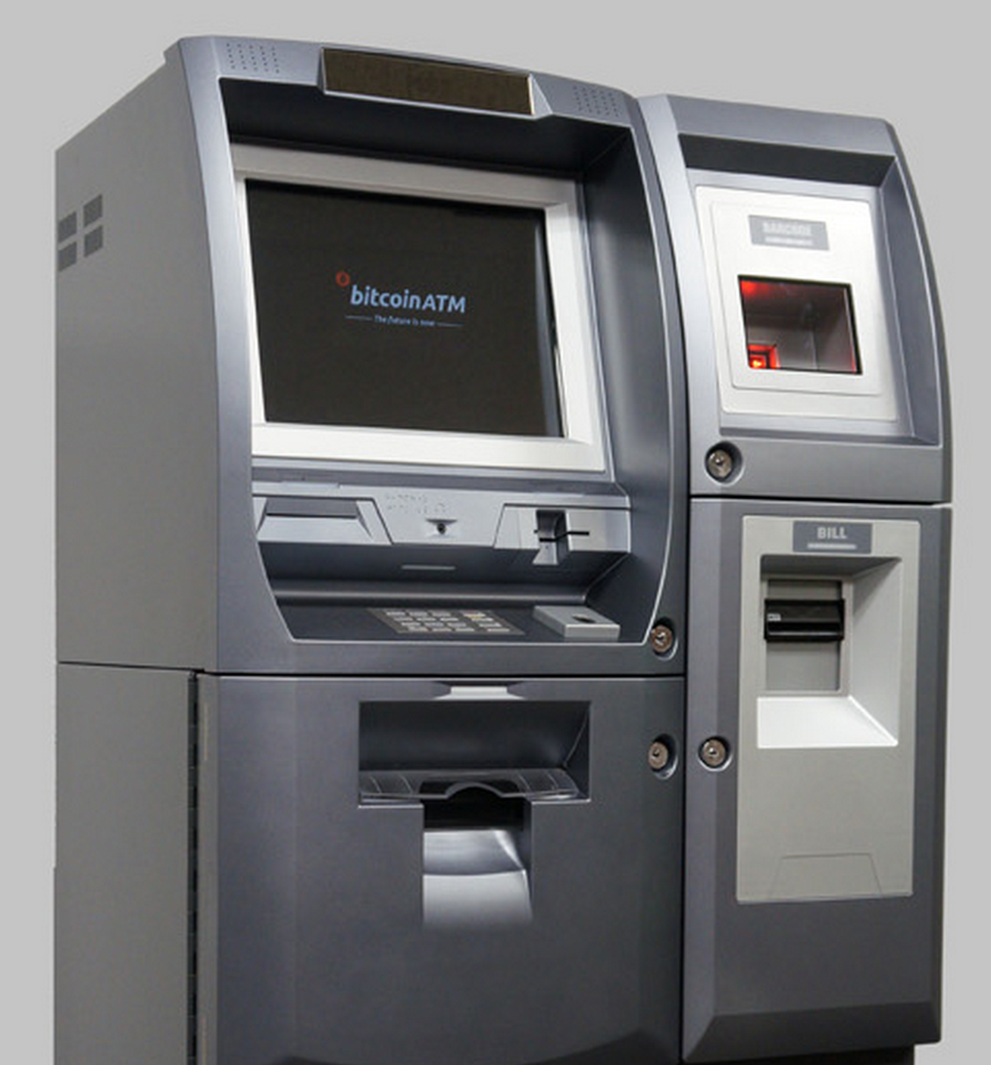
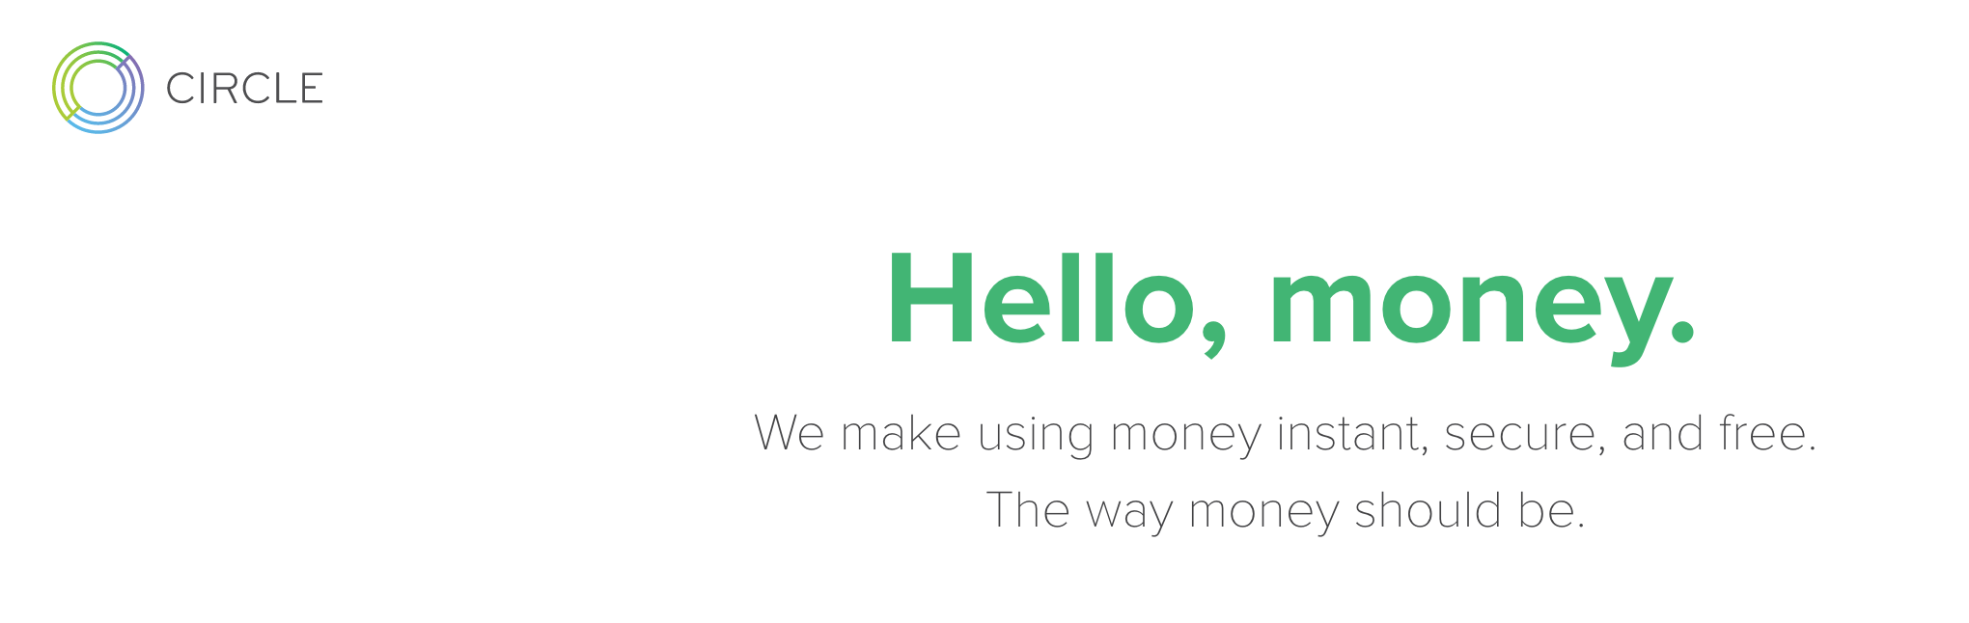

Buying Bitcoin

Slide 4
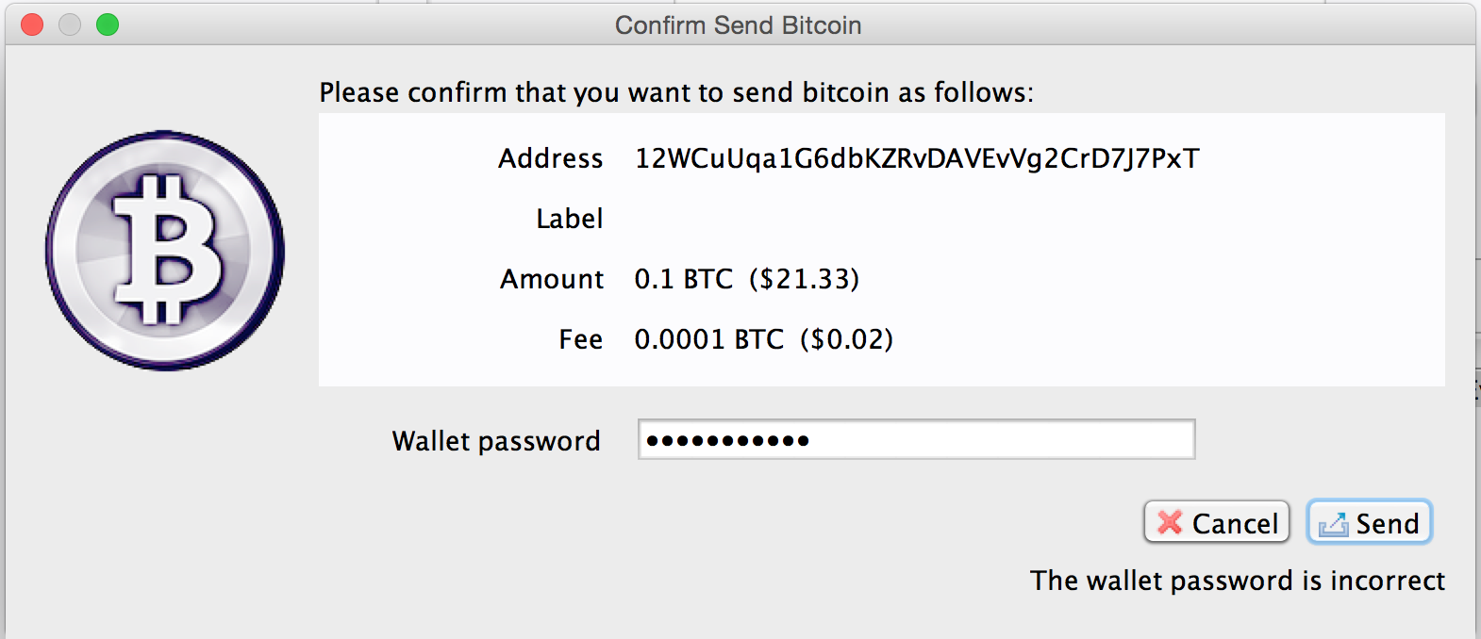

Slide 5
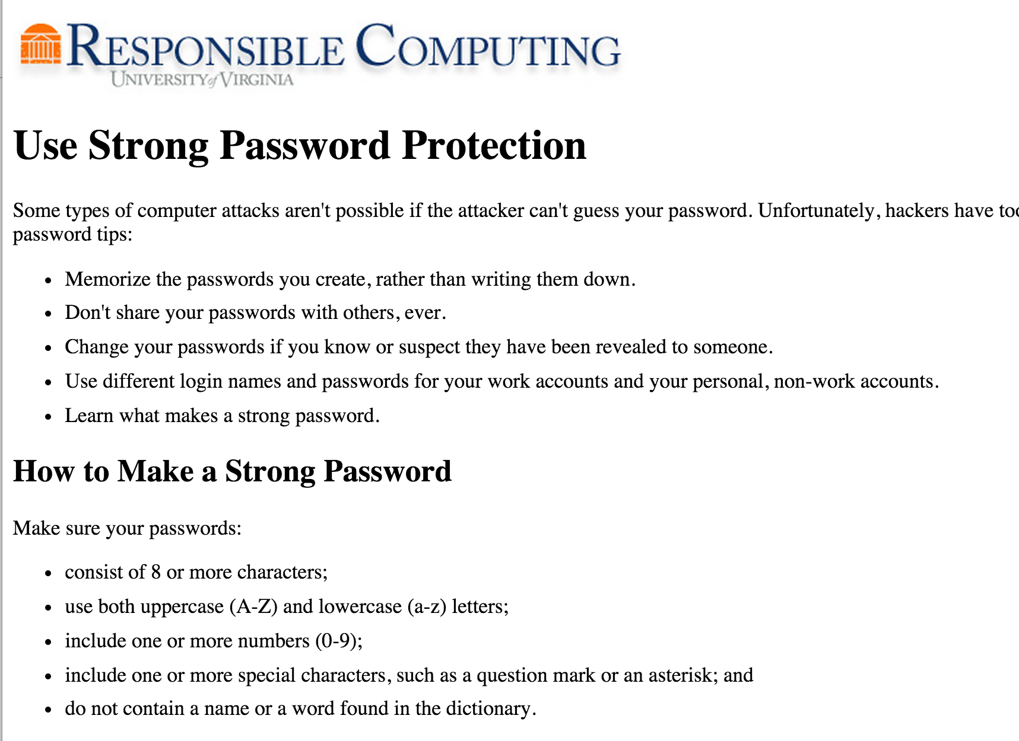

Slide 6
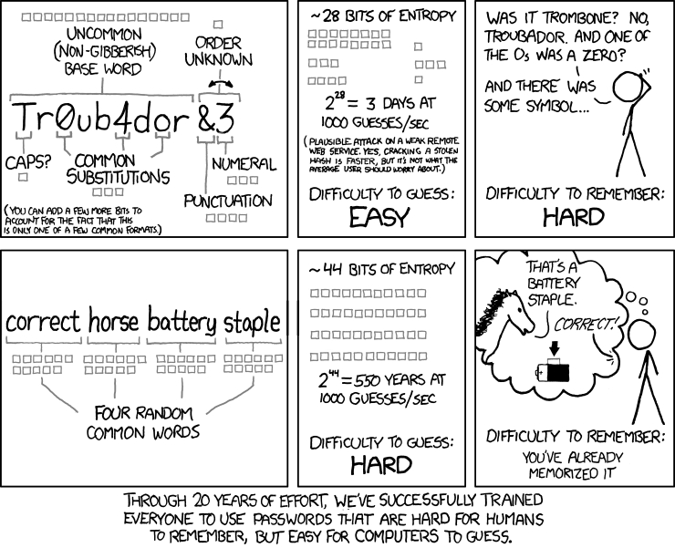

Slide 7
My Advice
Don’t waste brainpower/space on passwords that don’t matter
“silly” is a fine password for most things than need one
Don’t follow any widely-available advice
password cracker authors can read too!
Humans cannot generate randomness and neither can you
Generate a random password
Share your password
(but only with people with whom you are willing to raise children)
Write down your important passwords
Store them somewhere safe, and write down in a way that someone who steals it wouldn’t be able to use.

Slide 8
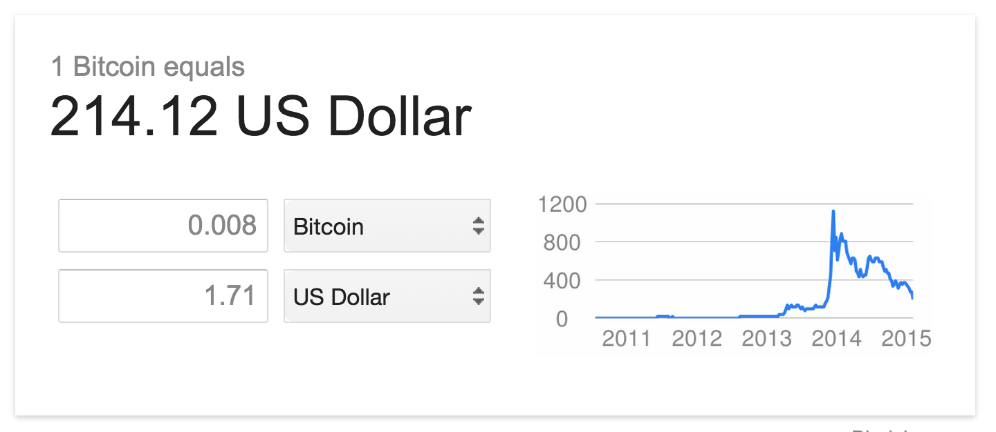
Using Bitcoin in This Class
It is “real” money: try not lose (all of) it. (But you can do everything in this class with very small amounts.)
If you do, I’ll send you more (so long as you learned something from the loss). Everyone gets one embarrassment-free transfer.

Slide 9
Using Asymmetric Crypto: Signatures
Anyone
Bob
Get KU_{B} from trusted provider
Generates key pair: KU_{B}, KR_{B}
Publishes KU_{B}
Verified
Message
E
Signed Message
D
Message
Insecure Channel
KU_{B}
KR_{B}

Slide 10

Transferring a Coin
Alice signs m₁ = { “I give coin x = KU_{A}, t to address KU_{B}.”} with KR_{A}.
How does Bob transfer x to Colleen (KU_{C})?

Slide 11
Transferring a Coin
Alice signs m₁ = { “I give coin x = KU_{A}, t to address KU_{B}.”} with KR_{A}.
Bob signs m₂ = { “I give coin x = KU_{A}, t, given to me by m₁to address KU_{C}.”} with KR_{B}.

Slide 12
Transferring a Coin
Alice signs m₁ = { “I give coin x = KU_{A}, t to address KU_{B}.”} with KR_{A}.
Bob signs m₂ = { “I give coin x = KU_{A}, t, given to me by m₁to address KU_{C}.”} with KR_{B}.
Colleen signs m₂ = { “I give coin x = KU_{A}, t, given to me by m₂to address KU_{D}.”} with KR_{C}.
…
This does not prevent double spending! (Next week)

Slide 13
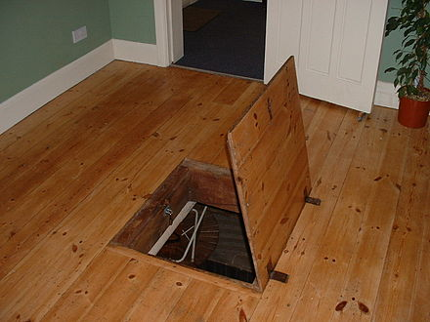
Asymmetry Required
Need a function f that is:
Easy to compute:
given x, easy to compute f (x)
Hard to invert:
given f (x), hard to compute x
Has a trap-door:
given f (x) and t,
easy to compute x

Slide 14
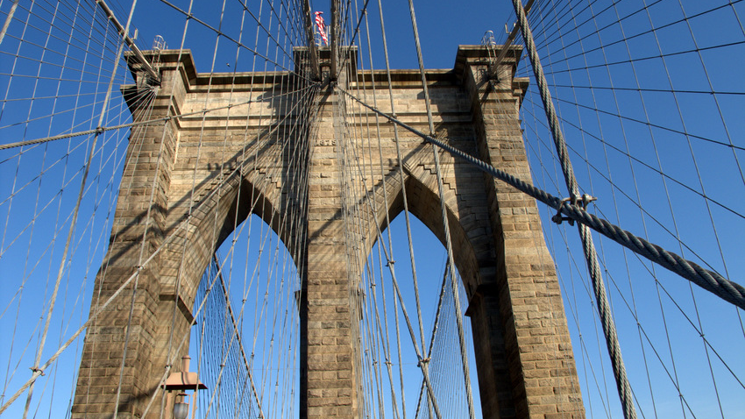
Elliptic Curve Cryptography

Slide 15
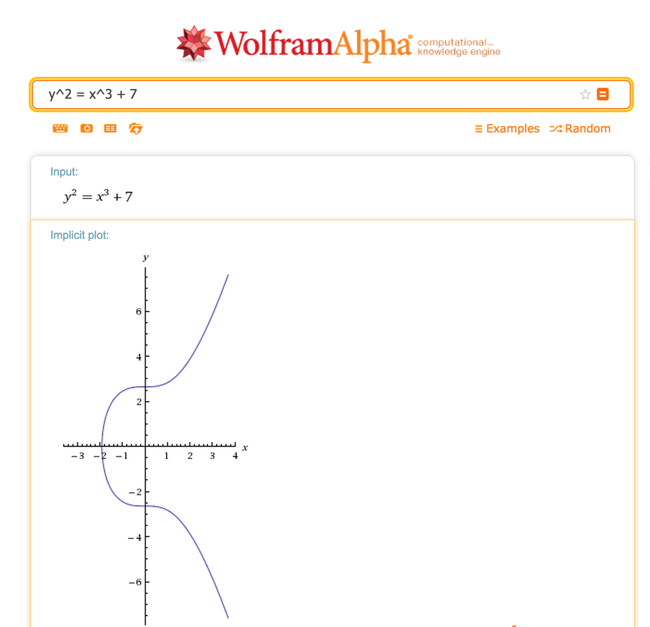


Real numbers are useless!

Slide 16
Groups
A group is a set, G, on which the operation ⊕ is defined with the following properties:
Closure: for all a, b ∈ G, a ⊕ b ∈ G.
Associative: for all a, b, c ∈ G, (a ⊕ b) ⊕ c = a ⊕ (b ⊕ c).
Identity: there is some element, 0 ∈ G, such that:
for all a ∈ G, a ⊕ 0 = 0 ⊕ a = a.
Inverse: for all a ∈ G, there exists an inverse, -a ∈ G, such that a ⊕ (-a) = 0.

Slide 17
Closure: for all a, b ∈ G, a ⊕ b ∈ G.
Associative: for all a, b, c ∈ G, (a ⊕ b) ⊕ c = a ⊕ (b ⊕ c).
Identity: there is some element, 0 ∈ G, such that:
for all a ∈ G, a ⊕ 0 = 0 ⊕ a = a.
Inverse: for all a ∈ G, there exists an inverse, -a ∈ G, such that a ⊕ (-a) = 0.
Is Integers, + a group?

Slide 18
Closure: for all a, b ∈ G, a ⊕ b ∈ G.
Associative: for all a, b, c ∈ G, (a ⊕ b) ⊕ c = a ⊕ (b ⊕ c).
Identity: there is some element, 0 ∈ G, such that:
for all a ∈ G, a ⊕ 0 = 0 ⊕ a = a.
Inverse: for all a ∈ G, there exists an inverse, -a ∈ G, such that a ⊕ (-a) = 0.
Is Naturals, + a group?

Slide 19
Closure: for all a, b ∈ G, a ⊕ b ∈ G.
Associative: for all a, b, c ∈ G, (a ⊕ b) ⊕ c = a ⊕ (b ⊕ c).
Identity: there is some element, 0 ∈ G, such that:
for all a ∈ G, a ⊕ 0 = 0 ⊕ a = a.
Inverse: for all a ∈ G, there exists an inverse, -a ∈ G, such that a ⊕ (-a) = 0.
Is Rationals, * a group?

Slide 20
Abelian Groups
A group is a set, G, on which the operation ⊕ is defined with the following properties:
Closure: for all a, b ∈ G, a ⊕ b ∈ G.
Associative: for all a, b, c ∈ G, (a ⊕ b) ⊕ c = a ⊕ (b ⊕ c).
Identity: there is some element, 0 ∈ G, such that:
for all a ∈ G, a ⊕ 0 = 0 ⊕ a = a.
Inverse: for all a ∈ G, there exists an inverse, -a ∈ G, such that a ⊕ (-a) = 0.
Commutative: for all a, b ∈ G, a ⊕ b = b ⊕ a.

Slide 21
Closure: for all a, b ∈ G, a ⊕ b ∈ G.
Associative: for all a, b, c ∈ G, (a ⊕ b) ⊕ c = a ⊕ (b ⊕ c).
Identity: there is some element, 0 ∈ G, such that:
for all a ∈ G, a ⊕ 0 = 0 ⊕ a = a.
Inverse: for all a ∈ G, there exists an inverse, -a ∈ G, such that a ⊕ (-a) = 0.
Commutative: for all a, b ∈ G, a ⊕ b = b ⊕ a.
Is Rationals – {0}, * an abelian group?

Slide 22
Finite Fields
A finite field is a set F of N ≥ 2 elements on which the operators ⊕ and × are defined with these properties:
The set F is an abelian group with identity 0 under the ⊕ operation.
The set F - { 0 } is an abelian group with identity 1 under the × operation.
Distributive: For all a, b, c ∈ F,
(a ⊕ b) × c = (a × c) ⊕ (b × c).

Slide 23
Know any finite fields?
A finite field is a set F of N ≥ 2 elements on which the operators ⊕ and × are defined with these properties:
The set F is an abelian group with identity 0 under the ⊕ operation.
The set F - { 0 } is an abelian group with identity 1 under the × operation.
Distributive: For all a, b, c ∈ F, (a ⊕ b) × c = (a × c) ⊕ (b × c).

Slide 24
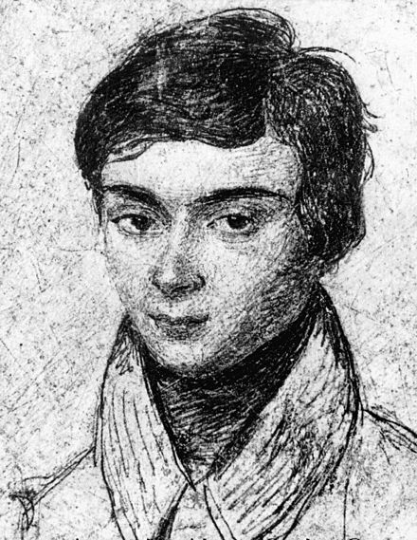
0
6
1
5
2
GF(7)
4
3
Évariste Galois
Killed in duel at 20

Slide 25
Prime Fields
Prime Field Theorem: For every prime number p, the set { 0, 1, …, p - 1 } forms a finite field with the operations addition and multiplication modulo p.

Slide 26
Elliptic Curves in Finite Fields
y² = x³ + 7 in GF(3)

Slide 27
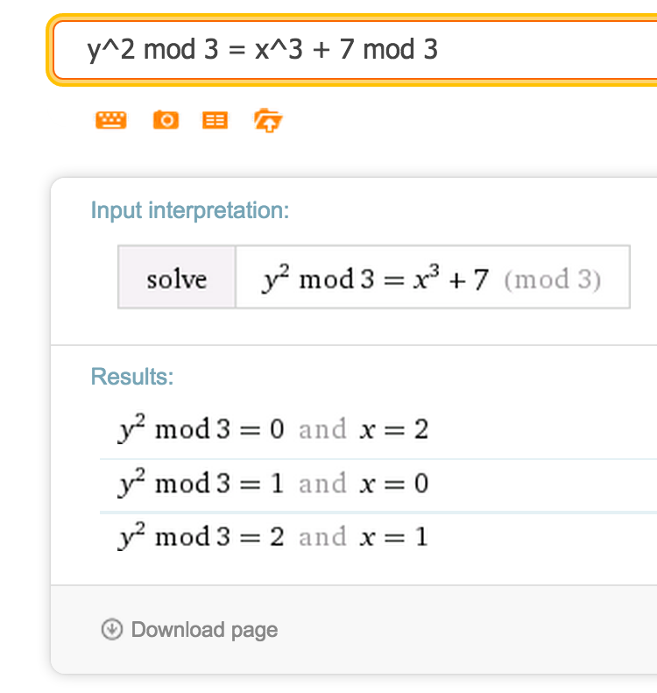
Elliptic Curves in Finite Fields
y² = x³ + 7 in GF(3)

Slide 28
Elliptic Curves in Finite Fields
y² = x³ + 7 in GF(2²⁵⁶ - 2³² - 2⁹ - 2⁸ - 2⁷ - 2⁶ - 2⁴ - 1)

Slide 29
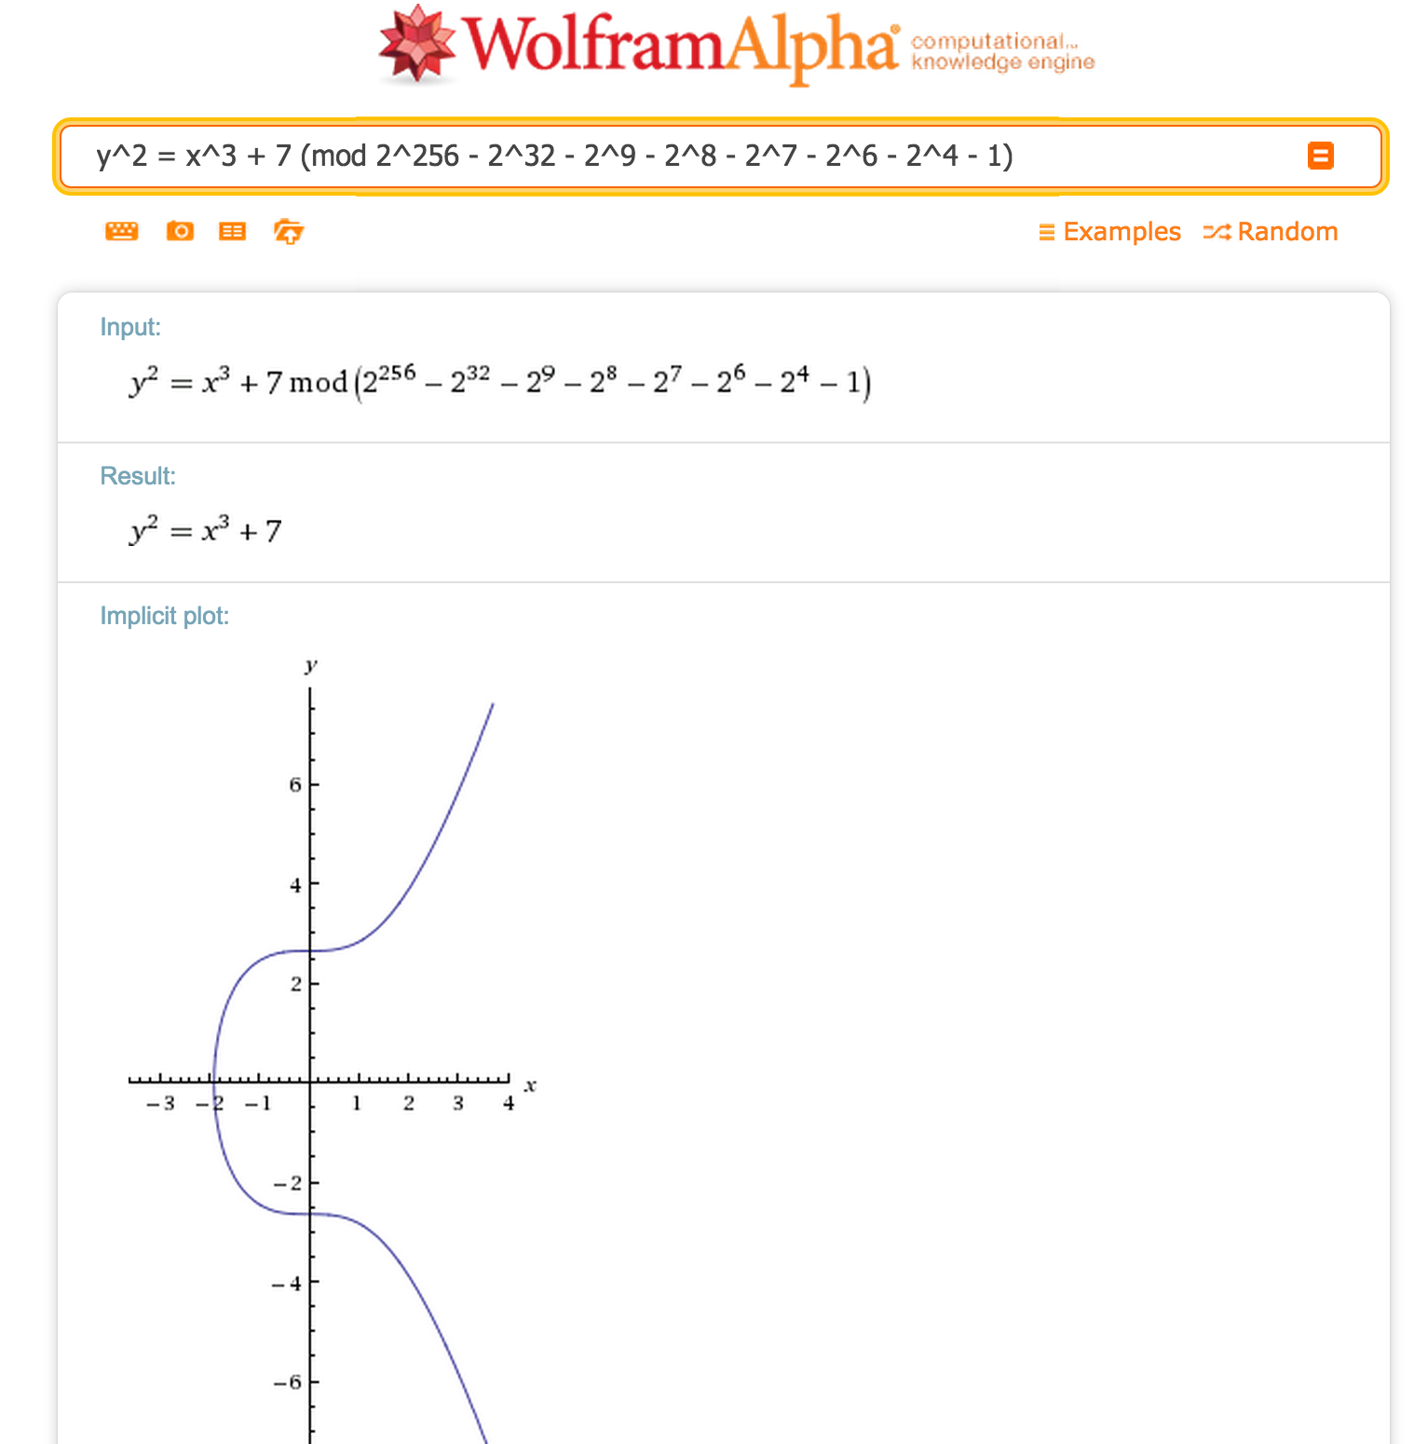
y² = x³ + 7 in GF(2²⁵⁶ - 2³² - 2⁹ - 2⁸ - 2⁷ - 2⁶ - 2⁴ - 1)
115 quattuorvigintillion 792 trevigintillion 89 duovigintillion 237 unvigintillion 316 vigintillion 195 novemdecillion 423 octodecillion 570 septendecillion 985 sexdecillion 8 quindecillion 687 quattuordecillion 907 tredecillion 853 duodecillion 269 undecillion 984 decillion 665 nonillion 640 octillion 564 septillion 39 sextillion 457 quintillion 584 quadrillion 7 trillion 908 billion 834 million 671 thousand 663
(0.0012 × the number of atoms in the visible universe)

Slide 30
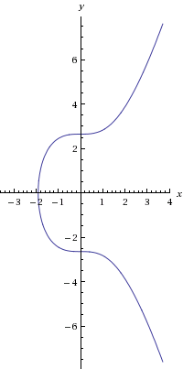
Addition on Elliptic Curves
P + Q
y² = x³ – 7 (mod p)
P
Q
Addition: P + Q
= negate intersection of curve with line through P and Q

Slide 31
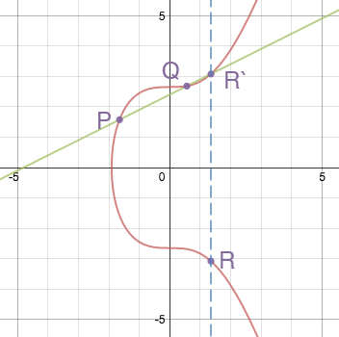
Addition
P + Q = R
What should we do if P = Q?
Image from: http://www.coindesk.com/math-behind-bitcoin/

Slide 32
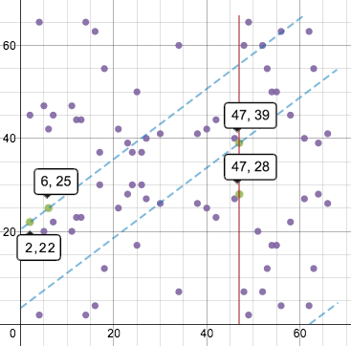
Addition
Same idea for finite fields (just more complex)
Picture is for F₆₇.
How would this look for F_{huge}?
Image from: http://www.coindesk.com/math-behind-bitcoin/

Slide 33
Density of Elliptic Curve
y² = x³ + 7 in GF(2²⁵⁶ - 2³² - 2⁹ - 2⁸ - 2⁷ - 2⁶ - 2⁴ - 1)

Slide 34


Slide 35
(Believed to be) Hard Problem
Elliptic curve discrete logarithm problem: given points P and Q on an elliptic curve, it is hard to find an integer k such that Q = kP.

Slide 36
Signing with Elliptic Curves
Elliptic curve discrete logarithm problem: given points P and Q, it is hard to find k such that Q = kP.
How can we use this hardness assumption to make asymmetric cryptosystem?

Slide 37
Signing with Elliptic Curves
Elliptic curve discrete logarithm problem: given points P and Q, it is hard to find k such that Q = kP.
How can we use this hardness assumption to make asymmetric cryptosystem?
Parameters: curve, G (a point on curve),
(large) n such that nG = 0.
Key pair:
Private key: d = pick a random integer in [1, n-1]
Public key: point Q = dG

Slide 38
Signing with Elliptic Curves
Parameters: curve, G (a point on curve),
(large) n such that nG = 0.
Key pair:
Private key: d = pick a random integer in [1, n-1]
Public key: point Q = dG

Slide 39
Signing with Elliptic Curves
Parameters: curve, G (a point on curve),
(large) n such that nG = 0.
Key pair:
Private key: d = pick a random integer in [1, n-1]
Public key: point Q = dG
Sign (sketch):
pick random integer k in [1, n-1]
compute curve point: (x, y) = kG
signature = (x mod n, k⁻¹(z + rd) mod n)

Slide 40
Verifying a Signature
Parameters: curve, G (a point on curve), (large) n such that nG = 0.
Key pair:
Private key: d = pick a random integer in [1, n-1]
Public key: point Q = dG
Sign (sketch):
pick random integer k in [1, n-1]
compute curve point: (x, y) = kG
signature = (x mod n, k⁻¹(z + rd) mod n)
Q is on the curve,
nQ = 0
Q must not be 0
1. Verify Q is valid.

Slide 41
Verifying a Signature
Parameters: curve, G (a point on curve), (large) n such that nG = 0.
Key pair:
Private key: d = pick a random integer in [1, n-1]
Public key: point Q = dG
Sign (sketch):
pick random integer k in [1, n-1]
compute curve point: (x, y) = kG
signature = (x mod n, k⁻¹(z + rd) mod n)
2. Verify signature is valid.
Compute curve point using
Q, z, and signature, and check it.

Slide 42
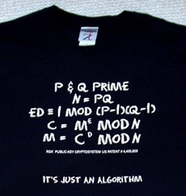
Why Elliptic Curve instead of RSA?

Slide 43
 | RSA | ECC
Discovery | 1977 (previously discovered in 1969 by GHCQ and perhaps earlier by NSA) | 1985 (adoption limited until ~2005)
“Hard” Problem | Factoring | Discrete Log on Elliptic Curve
Key Size (~112-bit) | 2048 bits (768 bits broken) | 224 bits (112 bits broken)
Backdoor Risk | None | Curves selected by NSA/Certicom/?
Quantum Computing Risk | Known fast factoring algorithms (Shor’s) | Similar (variation of Shor’s algorithm solves Discrete Log)
Implementation Challenges | Avoiding weak keys, timing side channels | Fast operations on elliptic curves, leaks on invalid inputs

Slide 44
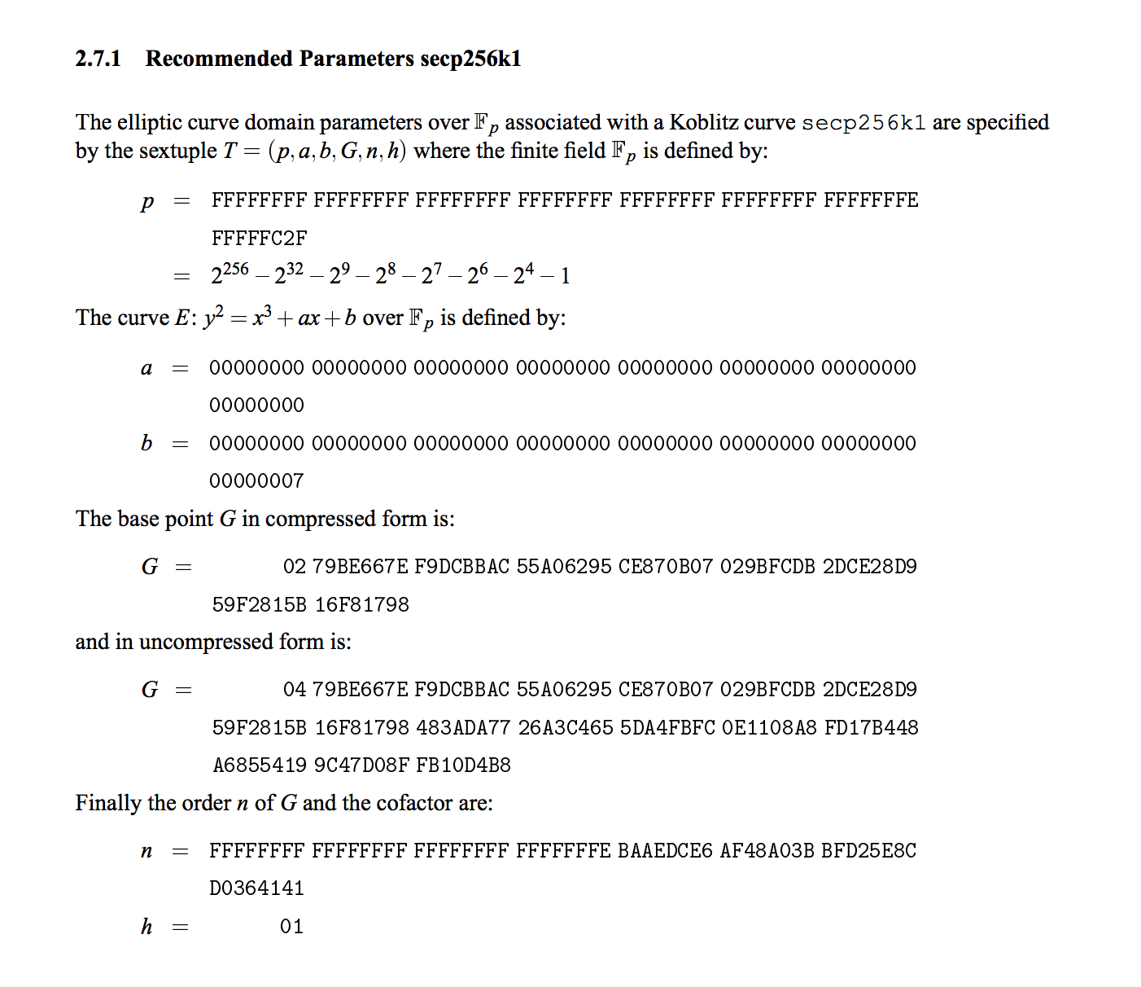
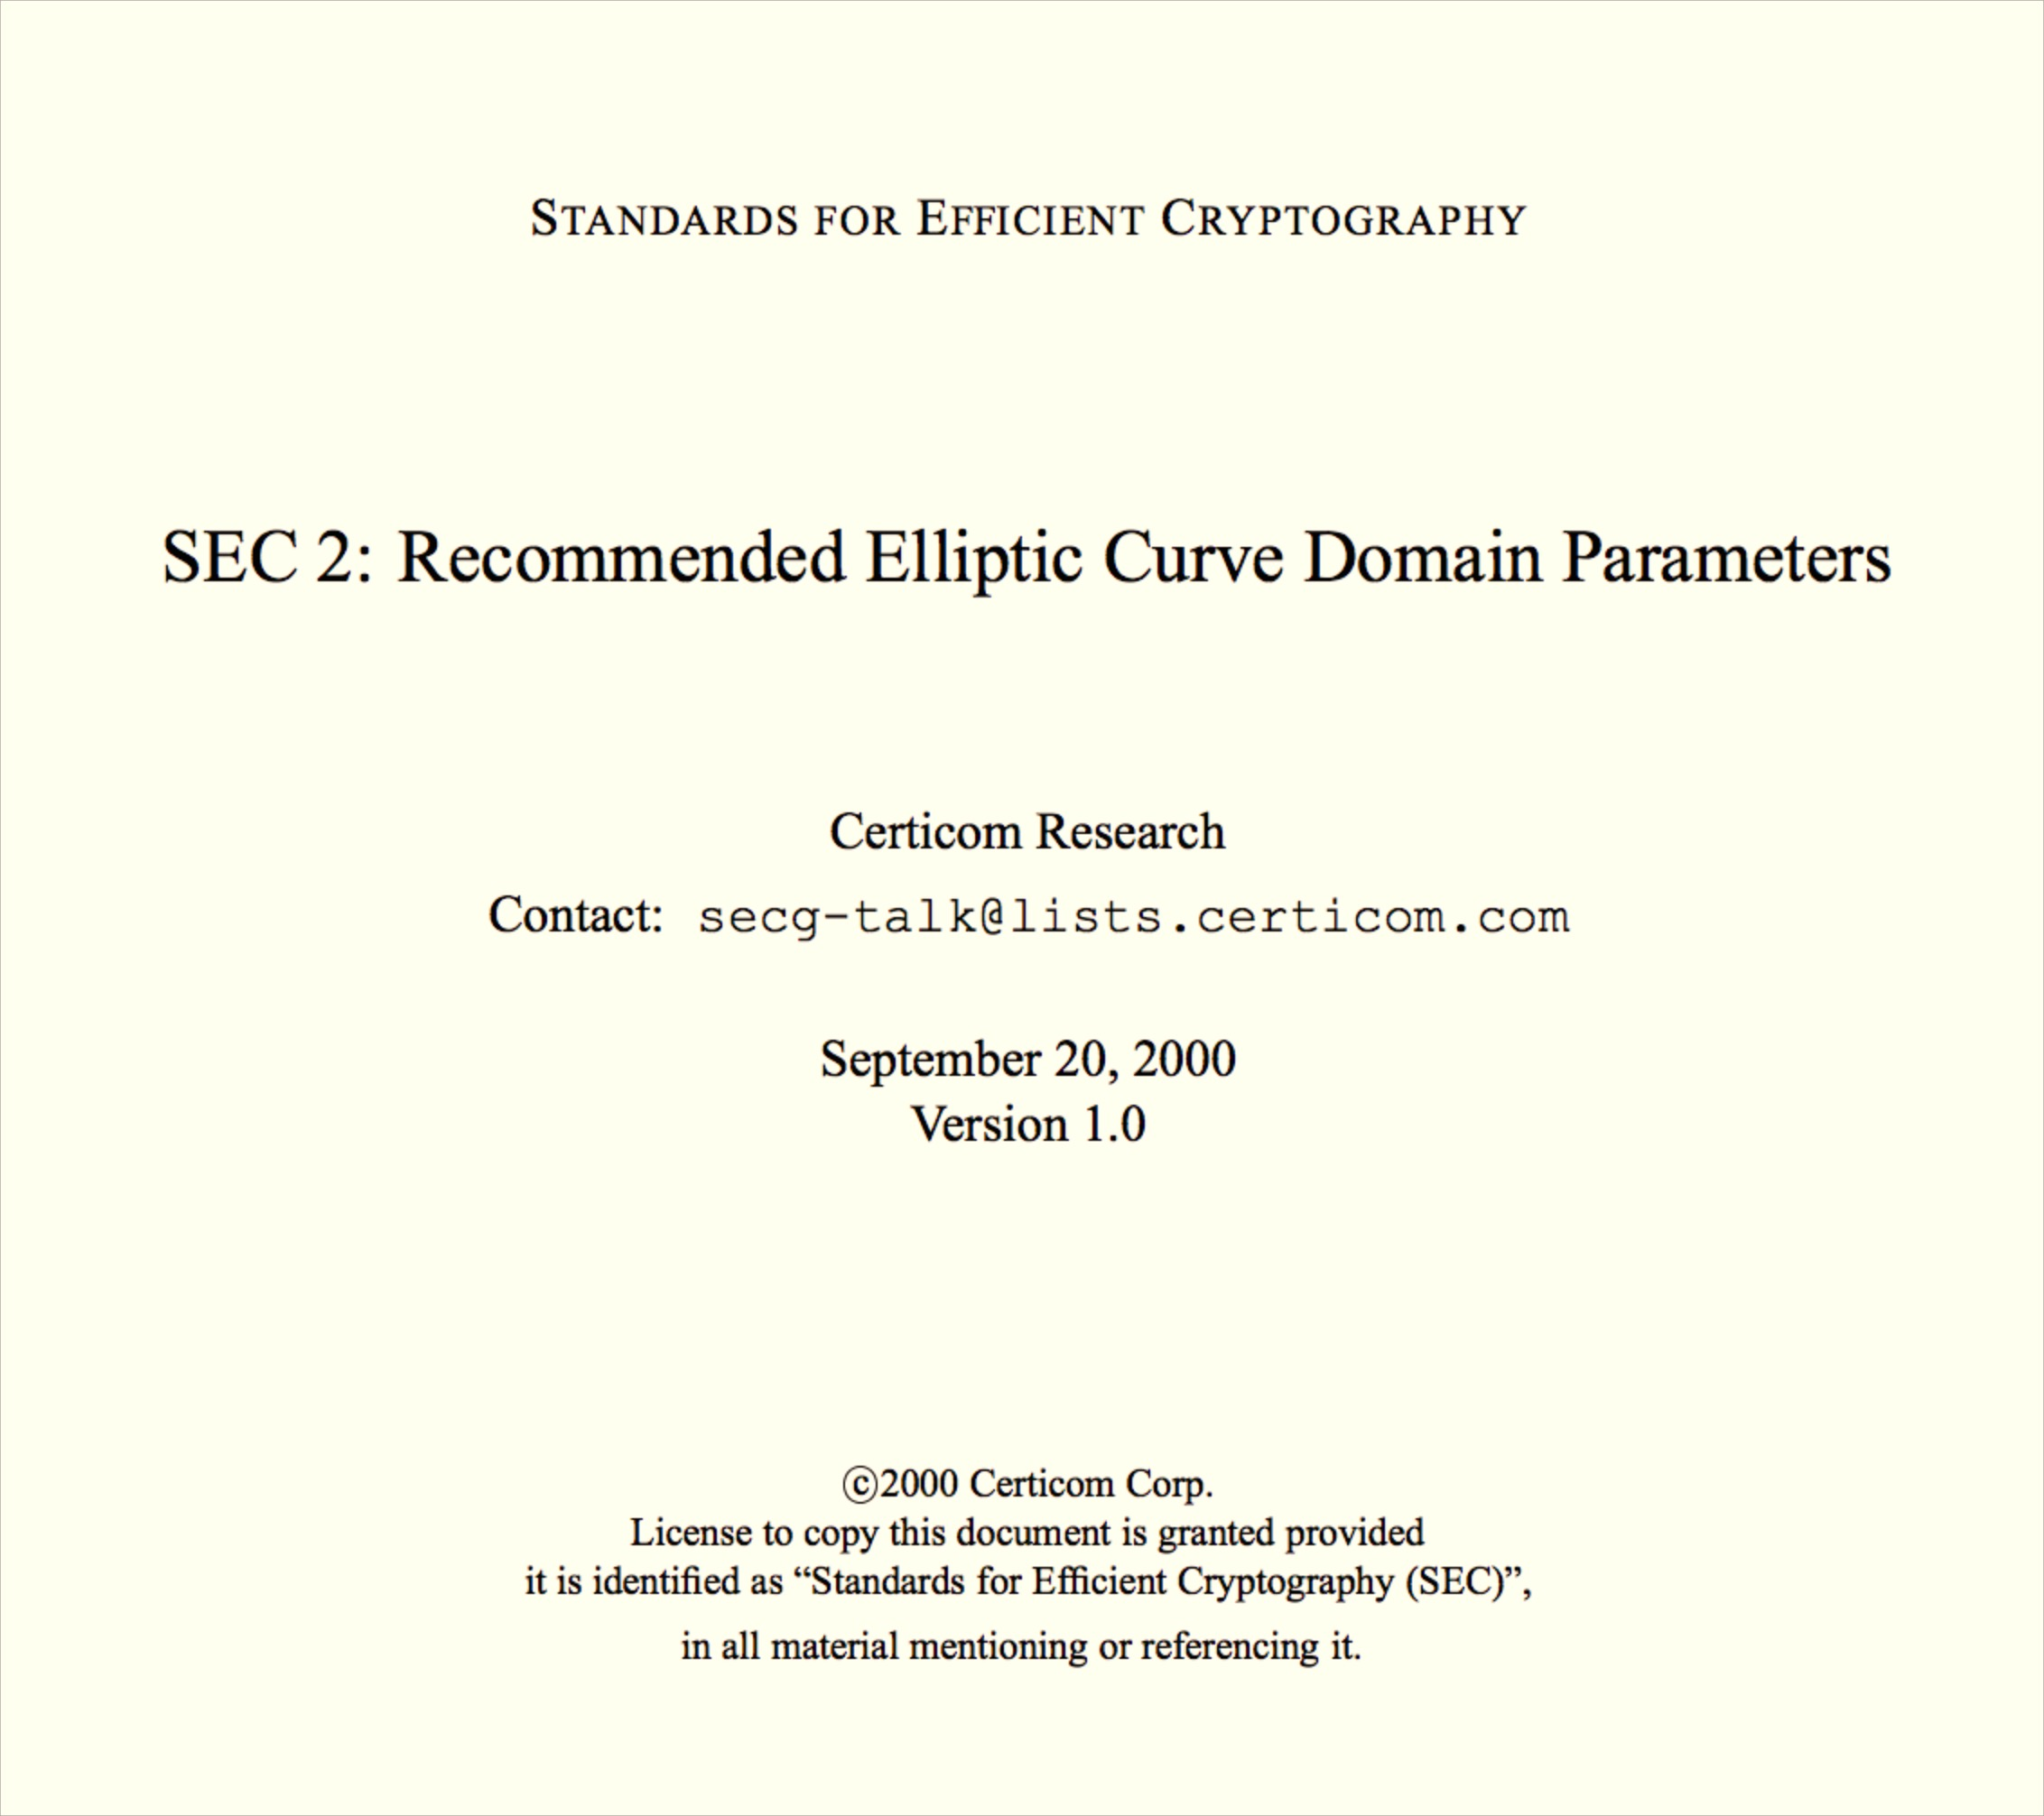
Bitcoin’s Curve

Slide 45
Randomness Matters
Parameters: curve, G (a point on curve),
(large) n such that nG = 0.
Key pair:
Private key: d = pick a random integer in [1, n-1]
Public key: point Q = dG
Sign (sketch):
pick random integer k in [1, n-1]
compute curve point: (x, y) = kG
signature = (x mod n, k⁻¹(z + rd) mod n)
How can we actually pick random integers?

Slide 46
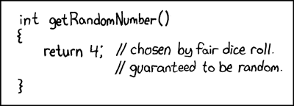
Is 4 a random number?

Slide 47
Dual-EC PRNG
P and Q are points on an elliptic curve
s₀ ⬅ physical randomness
s_{i}
r_{i} = φ(s_{i} ×Q)
s_{i +1}= φ(s_{i} ×P)
16 least significant bits of r_{i}’s x-coordinate
Update Internal State
Generate Output Bits

Slide 48
Curve Used by Dual-EC PRNG
NIST P-256
y² = x³ + ax + b (mod p)
p = 2²⁵⁶ − 2²²⁴ + 2¹⁹² + 2⁹⁶ − 1
a = p − 3 = 115792089210356248762697446949407573530086143415290314195533631308867097853948
b = 41058363725152142129326129780047268409114441015993725554835256314039467401291
Elliptic curve operations are expensive! Dual-EC PRNG is 1000x slower than strong PRNG’s built using symmetric ciphers.

Slide 49
Why would anyone use Elliptic Curves as basis for PRNG?
Easier to plant a back-door in it than designs based on symmetric ciphers
Can be used to provide provable security properties based on number theory: hardness of discrete log on elliptic curves
But not done for Dual EC PRNG

Slide 50
Dual-EC PRNG Proposed as NIST standard (2005)
s₀ ⬅ randomness
P and Q are (random?) points on P-256.
s_{i}
r_{i} = φ(s_{i} ×Q)
s_{i +1}= φ(s_{i} ×P)
16 least significant bits of r_{i}’s x-coordinate
Update Internal State
Generate Output Bits

Slide 51
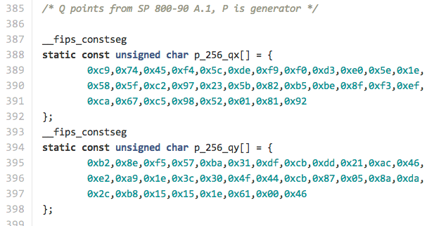
Image credit: Matthew Green
OpenSSL-FIPS Implementation (using NIST P and Q values)

Slide 52
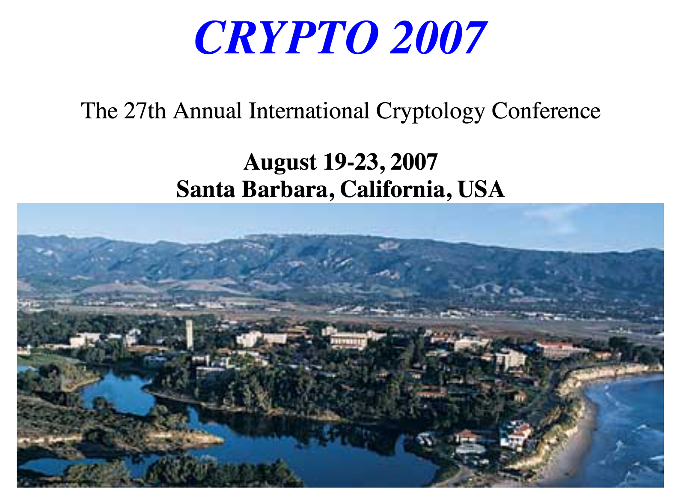
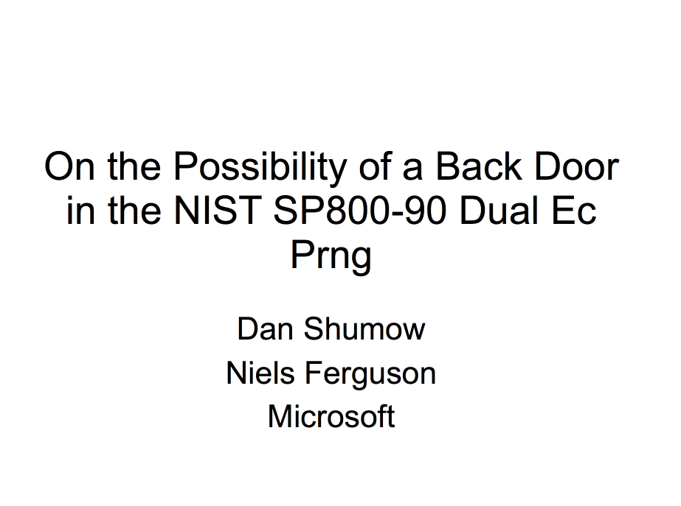
“Rump session” talk at CRYPTO 2007:
You can choose Q such that: Q = dP
then, it is easy to find e such that: P = eQ
and then easy to learn state of PRNG from just one output!

Slide 53
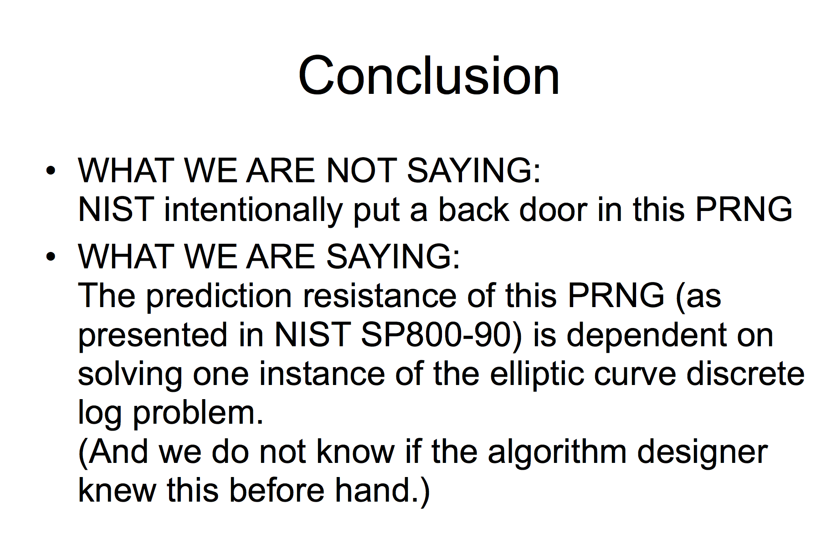
Shumow and Ferguson’s conclusion:

Slide 54
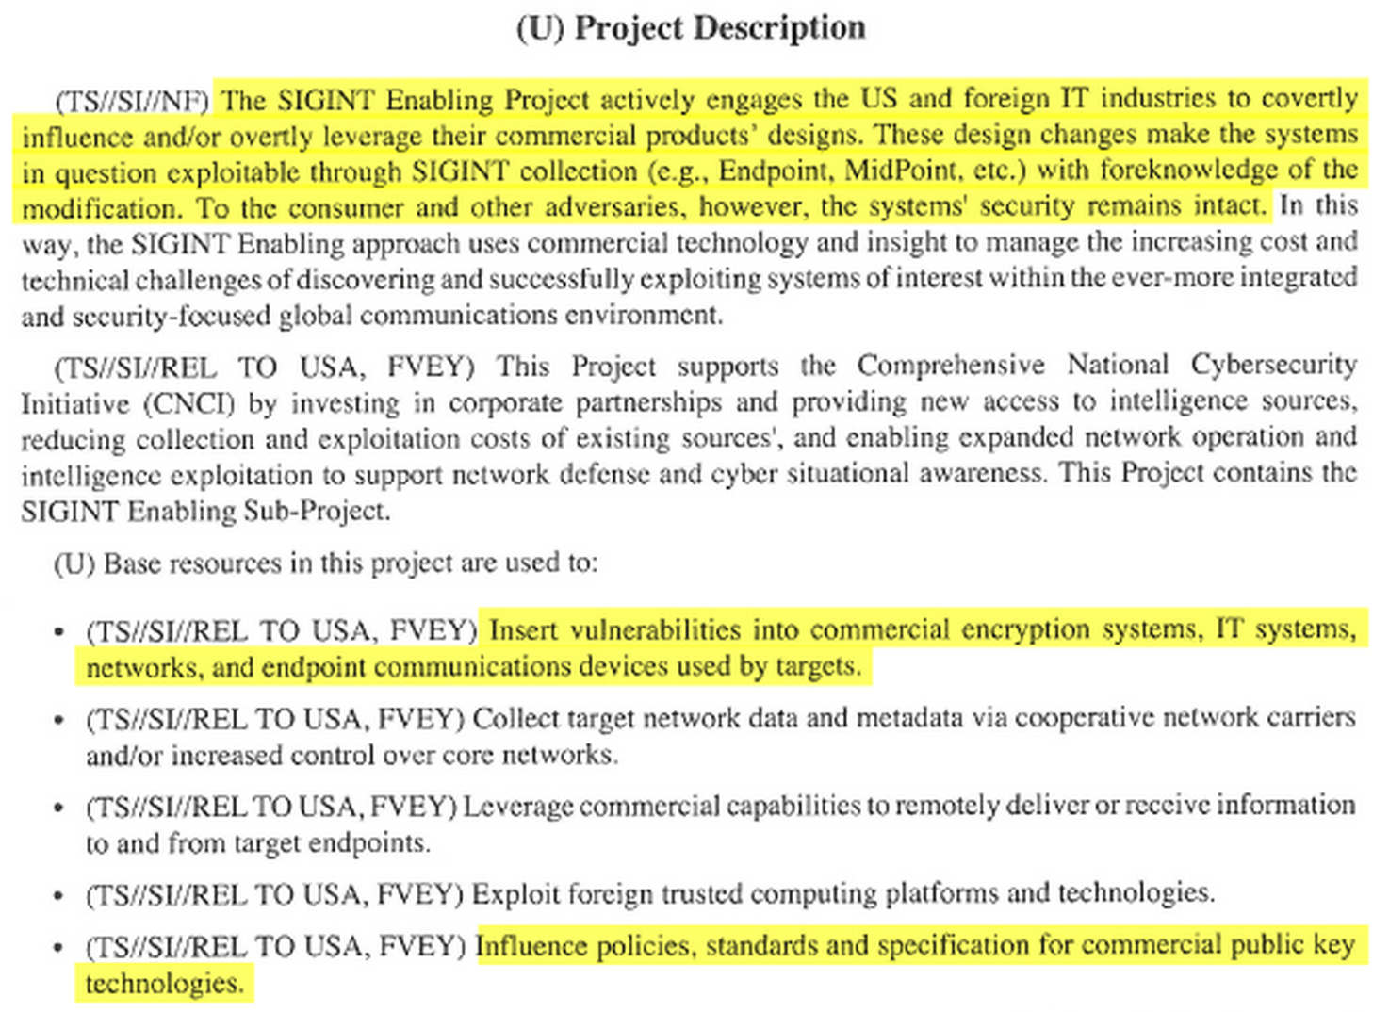
Snowden Leak (5 September 2013)
2013 Intelligence Budget Request ($250M)
2013 Intelligence Budget Request

Slide 55

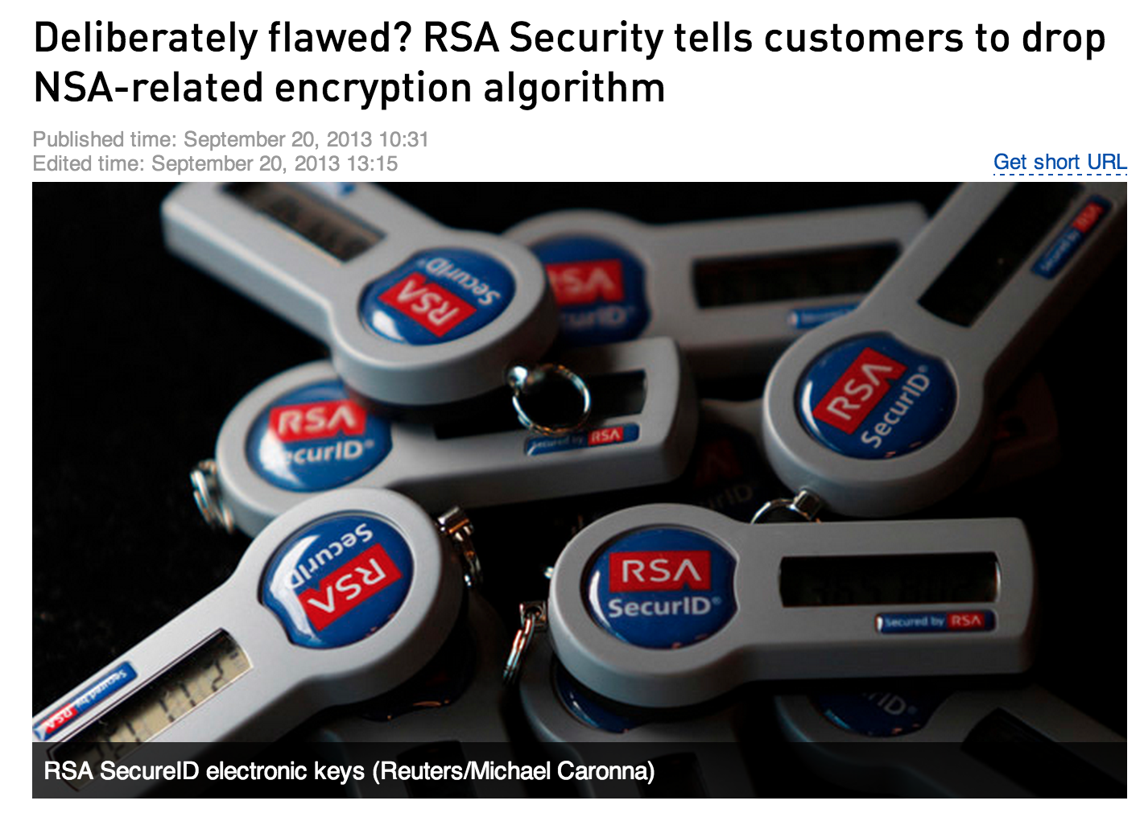
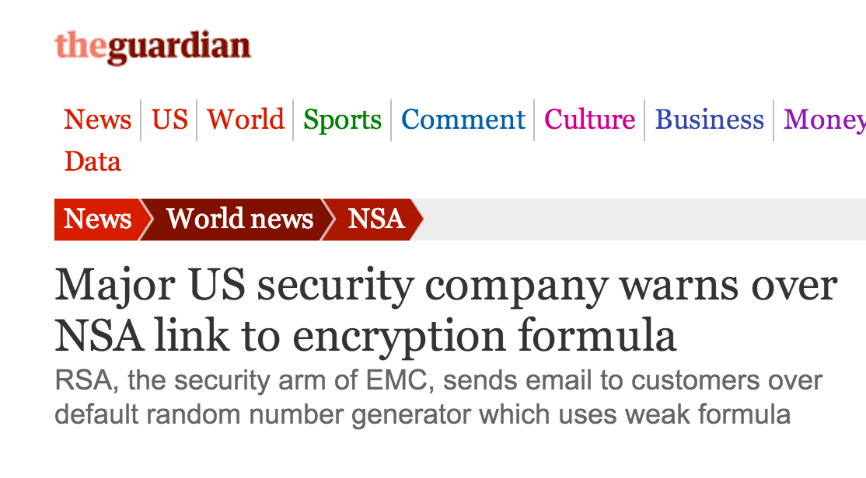
September 2013

Slide 56

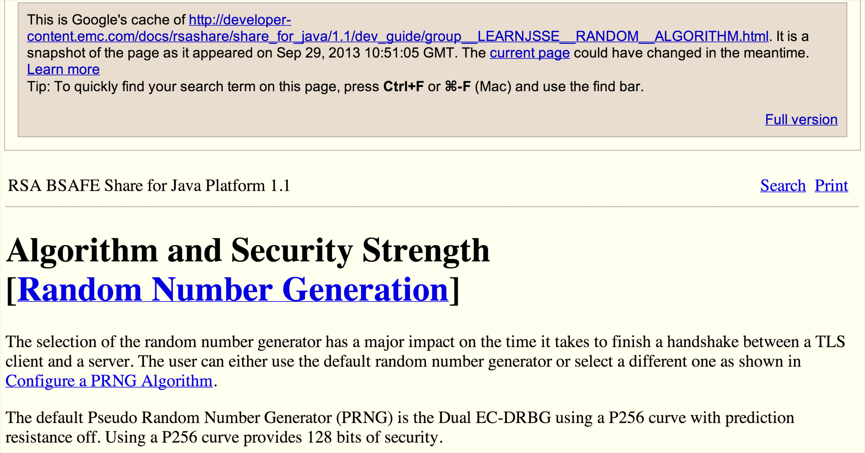

Slide 57
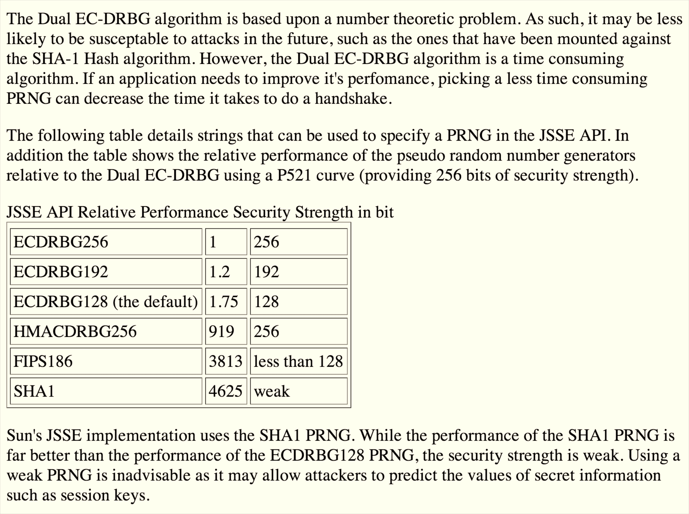

Slide 58
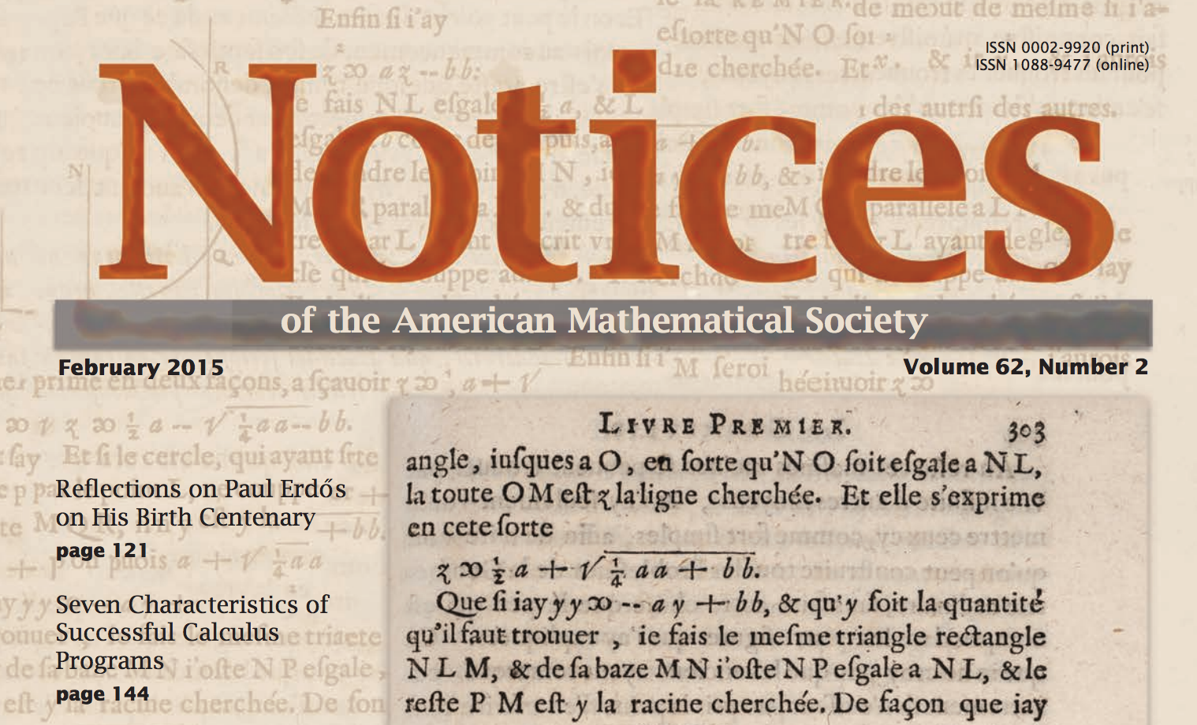
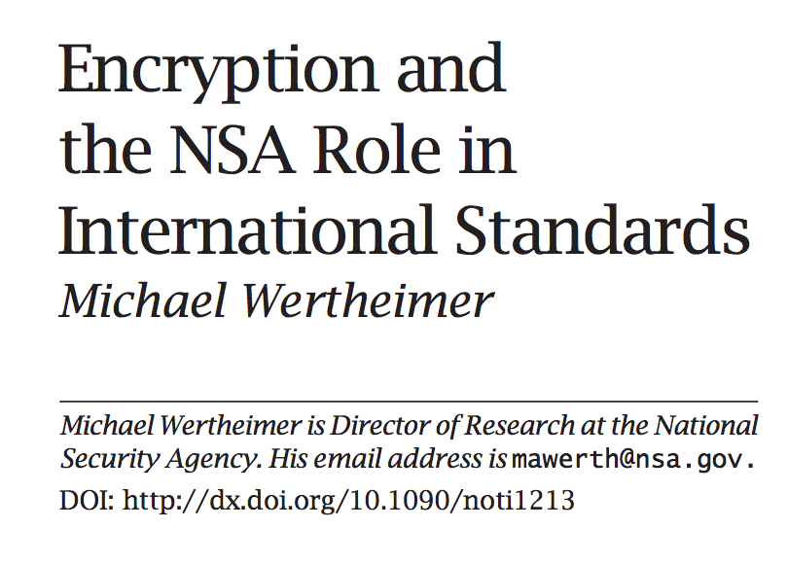

Slide 59
With hindsight, NSA should have ceased supporting the dual EC_DRBG algorithm immediately after security researchers discovered the potential
for a trapdoor. In truth, I can think of no better way to describe our failure to drop support for the Dual_EC_DRBG algorithm as anything other than regrettable. …
Furthermore, we realize that our advocacy for the DUAL_EC_DRBG casts suspicion on the broader body of work NSA has done to promote secure standards. Indeed, some colleagues have extrapolated this single action to allege that NSA has a broader agenda to “undermine Internet encryption.”

Slide 60
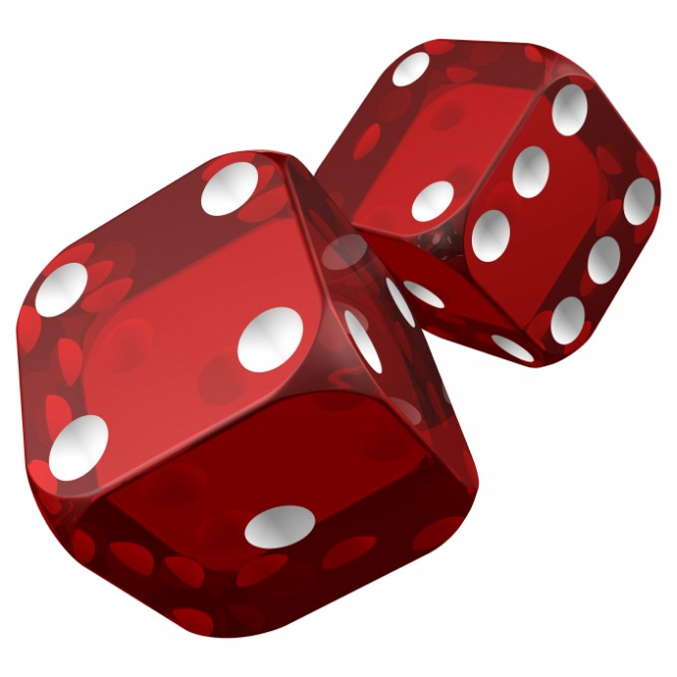
Generating Randomness for Your Private Key

Slide 61
Charge
Investigate the bitcoin you received
Project 1 will be posted before midnight tonight and due on Jan 30
Readings: Satoshi’s original bitcoin paper, Chapter 5

